Slide 1
Investigating Quality Education from school surveys
CSE 545 (Big Data Analytics) Project Presentation
Authors : Rishabh Goel , Harshit
Aakash Deep, Shikha Gupta
Team Spark Champs

Slide 2
Introduction
Past Work
Data
Methods and Evaluation
Conclusion
Contents

Slide 3

Introduction
Institutions
Decides Policy
Allocate Resources
Policy Improvement
Feedbacks
Educational Units
Surveys indicate how effective are the policies
Deploy/Use resources

Slide 4

Why Care? SDG 4- Quality Education
SDG 4 - ensure quality education accessible to all by 2030
262 million between age 6-17 were still out of school in 2017.
Percentage of trained primary school teachers stagnant at 85 since 2015.
Ground reality of government measures can be understood by student and teacher feedbacks.
Study Hours highest for UAE but learning outcomes are poor
Study Hours lowest for Finland but student performance high
Image Credits : https://leverageedu.com/blog/best-education-system-in-the-world/

Slide 5
Why Big Data?
Keywords
Process large data (~20 GB)
Use techniques to analyse and obtain inferenes
Similarity Analysis
Multi-Hyp Testing
Large Scale Machine Learning
Need to use data pipeline to distribute the tasks on nodes and aggregate results
HDFS
PySpark
Tensorflow
SDG Goal 4.1.1 ⇒ Achieving target proficiency level in Literacy and Numeracy
Feedback features ⇒ Students’ responses on survey questions [done by PISA]
Subject Scores ⇒ Students’ scores in different subjects [done by PISA]

Slide 6
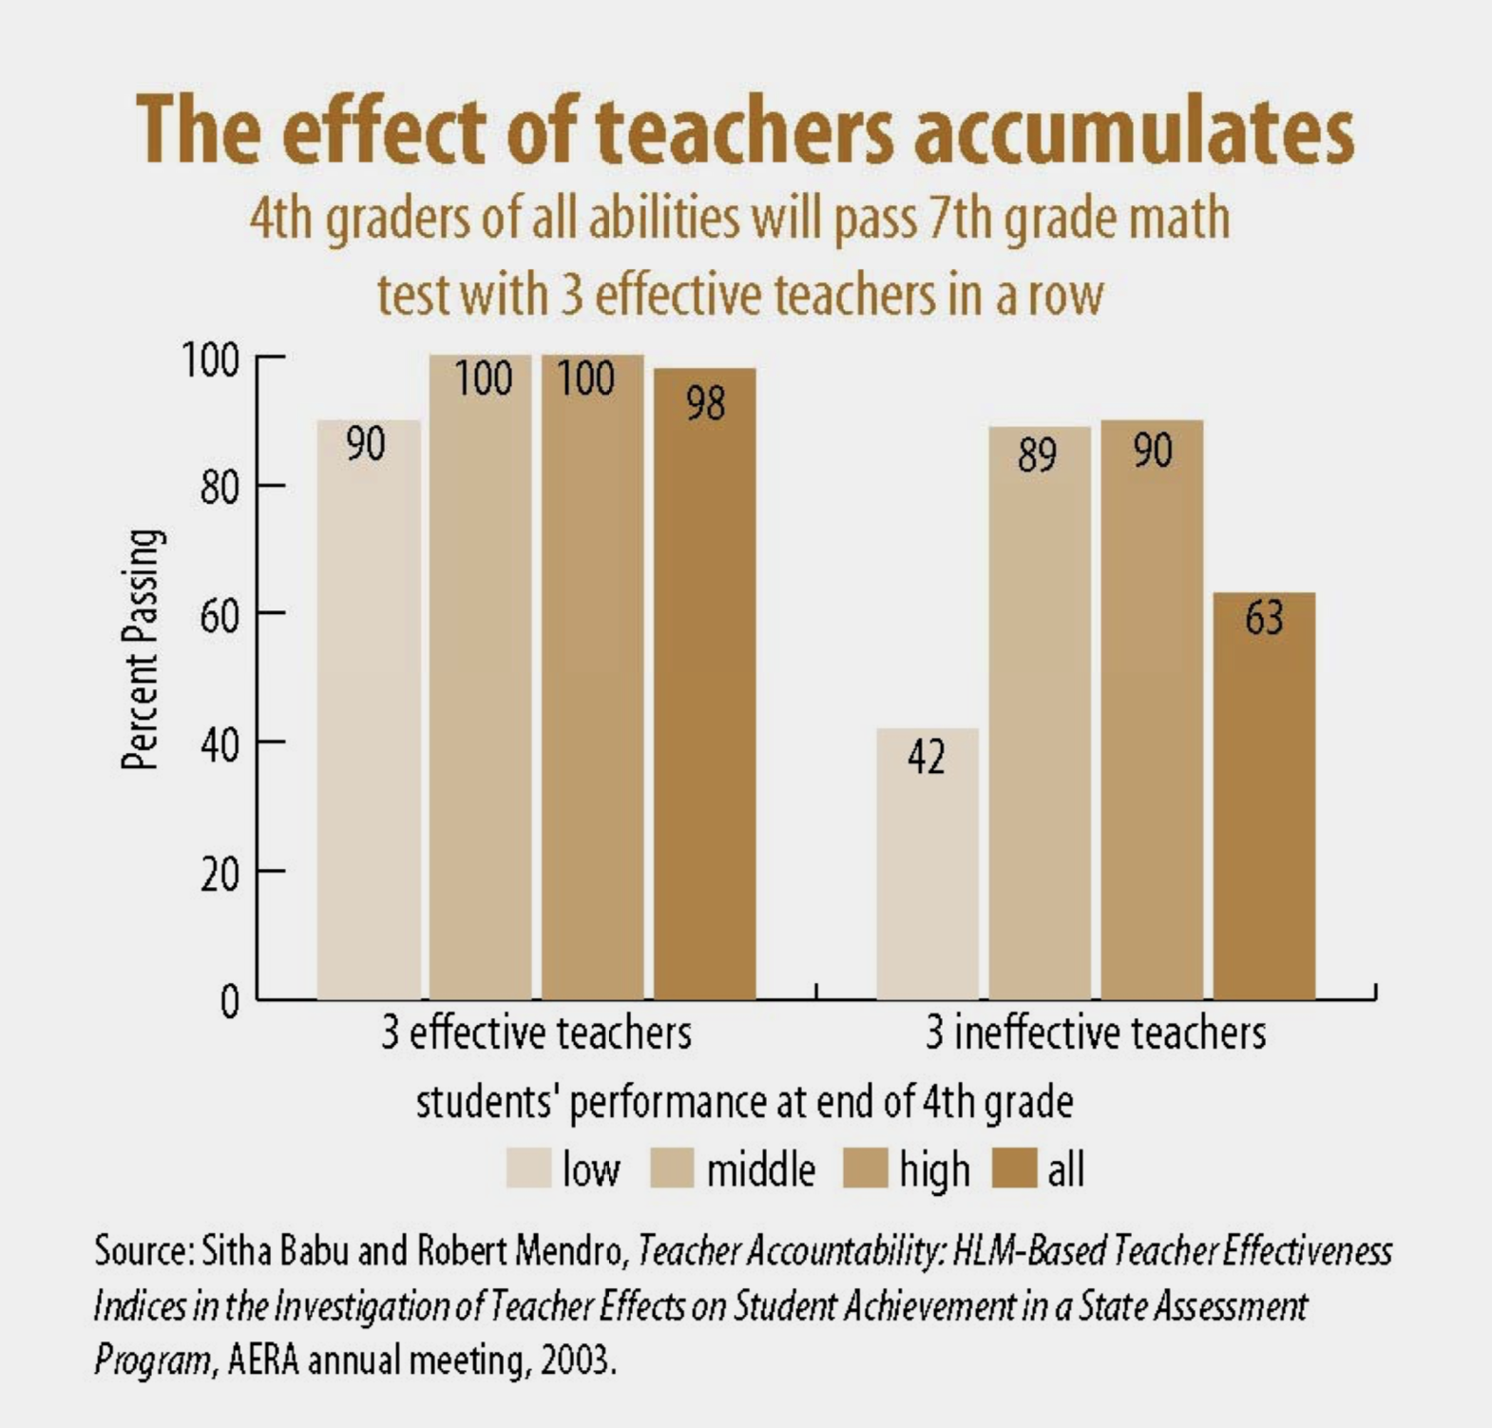
Background
Studies [Ref 2.] shows that school and family have only very little impact on academic achievement among pupils from disadvantaged backgrounds.
But Teachers are the most influential factor in student learning.
Image Credits: References 2

Slide 7
Past Work
Multinomial regression analysis was conducted[Ref1] to identify characteristics of students
Students for scholarship
Extracurricular activities
Parents’ education
University they study in
which make perception about quality of higher education dissimilar.
Studies [Ref2] shows that “Discovery”-based approaches have produced very positive outcomes in classes taught by exceptional and highly committed educators.
However,considerable time and energy is required on the part of the individuals, average teacher is undoubtedly not in a position to contribute.

Slide 8
Data
PISA [~20 GB] (https://www.oecd.org/pisa/)
Reading, mathematics and scientific literacy scores of more than 710,000 15 - year old students representing 31 million student from 79 countries. Along with general survey from teachers, parents school principal and students every 3 year since 2000
Number of features > 1120, observations > 1 million
Representative Data, Feedback Data (ST*), Subject Scores (PV*)
UNESCO SDG [1 GB] (UIS Statistics)
Country wise quality indicators per year (1970-2019) (1GB)
Number of Features: >3000

Slide 9
Methods
Spark + GCP Cluster
HDFS
Pre-processing
Multi
Regression
Top Feedback Variables
UIS
Pre-processing
LSH
Similar Area Codes
PISA
Pre-processing
Deep Learning (Tensorflow + GCP VMs)
Subject Score Prediction
Fig: Code Analysis Pipeline

Slide 10
Methods - Hypothesis Testing
Task :- Find Correlated Feedbacks for the success of a SDG Goal
Approach :-
Spark RDD, data ⇒ (Y = goal score, X = features) for each country
2 Target SDG goals
Multi-linear regression ⇒ beta value and
p value for each feature
Top positively and negatively
correlated features for each SDG goal
SDG 4.1.1 (b)
Feature
Beta Value
P value
ST153Q10HA
0.41500
0.0
11
1
ST207Q04HA
0.29350
0.0
2
ST166Q03HA
-0.23453
1.24e-55
-2
ST205Q02HA
-0.36735
6.4e-114
-1

Slide 11
Results - Hypothesis Testing
What language do you speak at home most of the time?
How often during lessons: The teacher asks questions to check whether we have understood what was taught?
Goal 4.1.1(b) :-
Achieving at least a minimum proficiency level in reading at the end of lower secondary education
In the last two full weeks of school, how often: I arrived late for school?
Thinking about : My parents support me when I am facing difficulties at school.
SDG Goal
How often during lessons: The teacher tells us what we have to learn?
Think about your school, how true: It seems that students are cooperating with each other?
Goal 4.1.1 (d) :-
Achieving at least a minimum proficiency level in mathematics at the end of lower secondary education
How often: Other students left me out of things on purpose?
Think about your school, how true: It seems that students are competing with each other?
Result: - Most or least correlated features for a given goal

Slide 12
Methods - Similarity Search
Clustering and Similarity Search using LSH
Task :- Find similar schools and areas from survey feedback collected from students
Approach :-
Characteristic matrix ⇐ buckets [0-20%, 21-40%, 41-60%, 61-80%, 81-100%] for feedback responses
Signature matrix (~1500 columns, ~60 rows) ⇐ Characteristic matrix (~1500 columns ~9000 rows).
Analysis on band values- (b=5,r=12), (b=8,r=8), (b=12,r=5) [Sim > 0.8]
Locality Sensitive Hashing ⇒ Similar area codes / schools (JSON)

Slide 13











Insights - Similarity Search
PHL0016
FIN0006
CAN1092
KAZ0212
FIN0001
FIN0010
MAR0003
ISL0002
MEX0004
USA0104
ALB0202
KAZ0107
AUS0412
RUS2323
Schools from some developing countries matched with some Finland area schools
Schools from some developed countries matched with some Finland area schools
Image Credits : Google Images

Slide 14
Methods - Deep Learning
Task :- Predict Performances in Subject based on students feed_back data
Approach :-
Distributed Preprocessing (using Spark Dataframes and HDFS, GCP Cluster 1 Master 2 Worker)
Distributed training [ TF2.0 Synchronous All Reduce ]
tf.distribute.MirroredStrategy - single node multi-gpu, each gpu have their parameter and update each other synchronously
GCP Compute Engine VMs with 2 Nvidia T4
Training time ~ little more than a minute per epoch
tf.distribute.experimental.MultiWorkerMirroredStrategy - multi node multi-gpu, each node communicate with each other in round-robin using RPCs

Slide 15
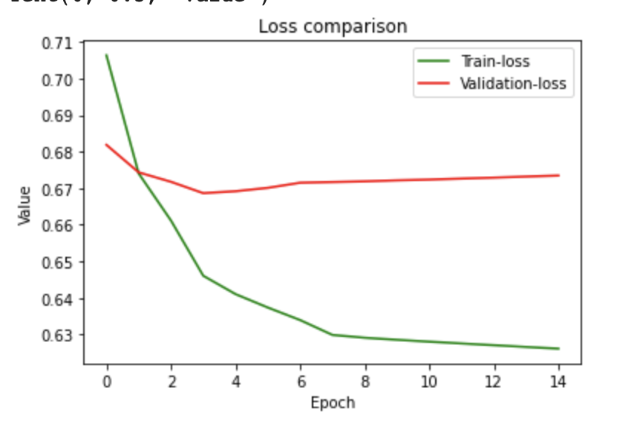
Insights - Deep Learning
Design :-
Inferences:
MAE for prediction 0.609 [standardized]
PV1MATH score for a sample
463 (Actual)
577 (Predicted)
Low Precision
tf.keras.layers.Dense
tf.keras.layers.Dense
tf.keras.layers.Dense
Input
Feedbacks
Output
Subject Scores
Layer 3
512
Neurons
Layer 1
1024 Neurons
Layer 2
1024 Neurons
Fig :- Network architecture with 3 hidden layers
Fig :- Training History

Slide 16

Conclusion
With our results ⇒ Feedbacks show a considerable importance in education quality
Cross-nation similar area codes found can help to decide similar policies, such as
Amount of teaching Hours
Degree of interaction between students
Institutions can decide to spend depending on type of students in particular region.
Inference on feedbacks can help achieve SDG goals
Future Work - more semantic analysis on feedbacks can produce higher efficient inferences regarding policy improvement.
Image Credits: https://myventurepad.com/software-education-something-constantly-revised/

Slide 17
References
https://www.tandfonline.com/doi/full/10.1080/23265507.2016.1155167
http://citeseerx.ist.psu.edu/viewdoc/download?doi=10.1.1.498.6274&rep=rep1&type=pdf
http://www.oecd.org/pisa/aboutpisa/
http://data.uis.unesco.org/#

